Slide 1

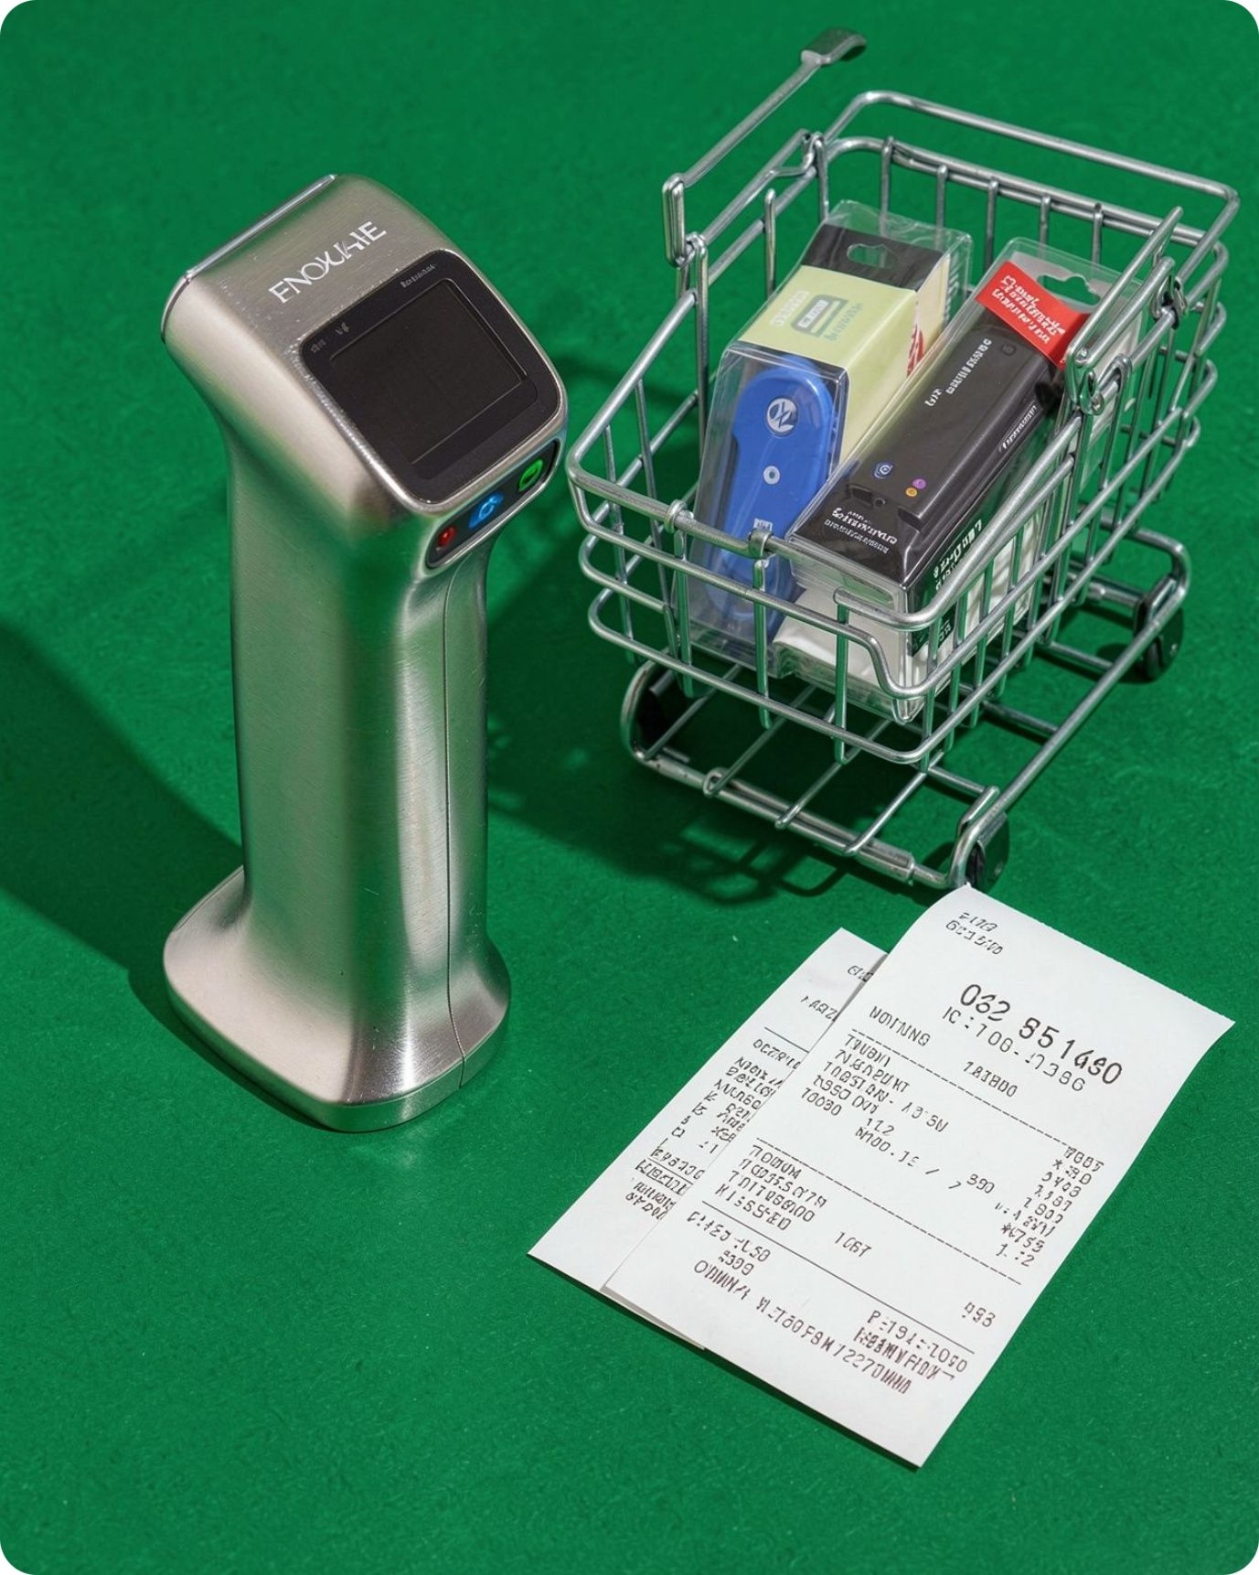
1.PROJECT INTRODUCTION
PROJECT TITLE : BUDGET SHOPPING OPTIMIZER
ONE LINE IDEA : CHOOSE THE MOST USEFUL COMBINATION OF PRODUCTS
WITHOUT GOING OVER YOUR BUDGET
TEAM MEMBERS : 25MVCSMR0003- A . SREEVARSHINI
25MVCSMR0017- C . SRIVALLI
25MVCSMR0020- CH . PRAVALIKA
25MVCSMR0031- D . YASHWANTH
PROBLEM DOMAIN: BUDGET PLANNING AND ALGORITHM OPTIMIZATION
Notes:
Introduce the Budget Shopping Optimizer as an explainable engine for getting maximum basket value from a fixed budget, with the project title, idea, team context, and retail optimization domain.

Slide 2
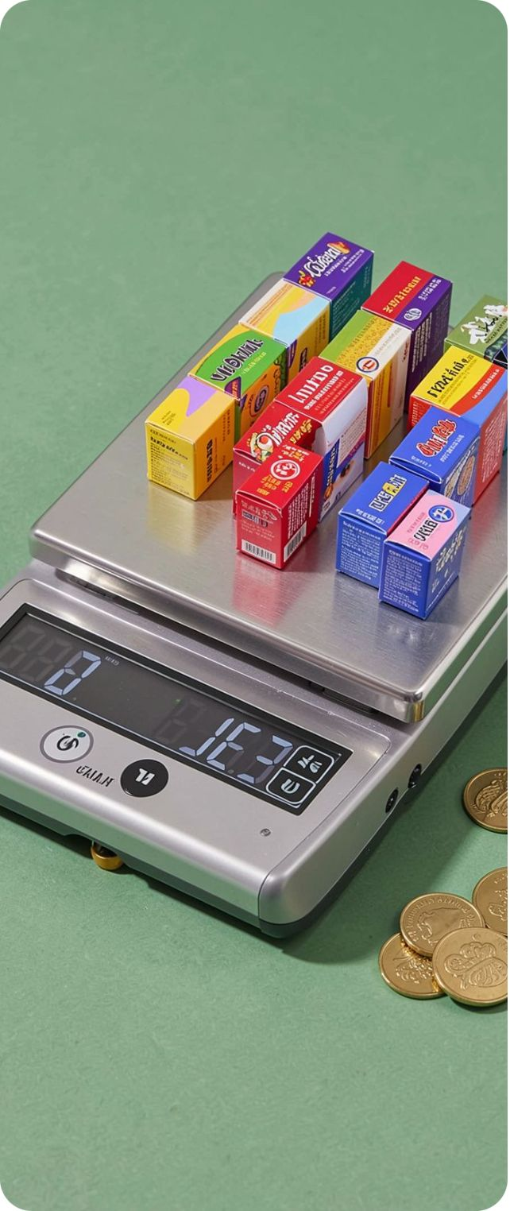
2. The Challenge
Shopping under a hard budget is a real-world optimization problem, not just a filtering task.
1
Real-world problem
Choose a basket that maximizes utility while staying within a spending ceiling.
2
Why it matters
Manual choices leave value or budget unused, while opaque recommendations hide the trade-offs behind every item.
3
Key challenges faced
Mathematical optimization beats shopping guesswork.
Combinatorial explosion, limited explainability, and the tension between globally optimal and instant decisions.
02
Notes:
Explain why manual shopping fails under tight budgets: evaluating every product subset is impractical, and shoppers either leave money unused or miss higher-utility combinations.

Slide 3
3. Our Innovation
One decision cockpit makes the trade-off between certainty, speed, and explainability visible in real time.
What makes it different
Core idea
Key features
Run 0/1 Knapsack dynamic programming and Greedy ratio sorting side by side on the same catalog and budget.
Live comparison metrics, item-level audit logs, and human-readable reasons for chosen, deferred, or skipped products.
It benchmarks an optimal mathematical solution against a fast heuristic instead of hiding the decision logic.
Unique approach
Shoppers see not just what to buy, but exactly why each algorithm made its choices.
03
Notes:
Walk the jury through the innovation: compare Dynamic Programming for the global optimum with Greedy for speed, then show how the explanation engine makes every trade-off auditable.

Slide 4
4. How It Works
A simple workflow turns a budget and product catalog into a recommended basket with a clear audit trail.
01
02
03
04
Input
Processing
Algorithm
Output
User enters a spending ceiling such as ₹10,000 and loads products with cost, utility, and category data.
The system computes utility-to-price density ratios across the available inventory.
It runs 0/1 Knapsack DP alongside Greedy ratio sorting for an instant comparison.
The dashboard returns selected items, total cost, utility, budget utilization, and itemized decision logs.
User journey
Set a budget → inspect the two baskets → understand the trade-off → choose with confidence.
04
Notes:
Highlight the four-step pipeline: set the budget, normalize product utility against price, execute both algorithms, and visualize the resulting baskets side by side with audit details.

Slide 5
5. Technology & Algorithm
Practical tools support a transparent comparison between optimality and responsiveness.
=>Tech stack
=>Main algorithms
Python 3.11: algorithmic implementation.
Streamlit: reactive UI with budget controls and live recalculation.
SQLite: persisted product inventory and CRUD operations.
0/1 Knapsack DP: guarantees the global optimum under the cap.
Greedy ratio sort: prioritizes utility per rupee for fast responses.
Why chosen
Together they expose the speed-versus-optimality trade-off.
=>Complexity
DP: O(n × W) time, O(n × W) or O(W) space · Greedy: O(n log n) time, O(n) auxiliary space.
05
Notes:
Showcase the stack and algorithmic rigor: Python, Streamlit, and SQLite make the prototype practical, while the two algorithms make complexity and value assurance easy to compare.

Slide 6
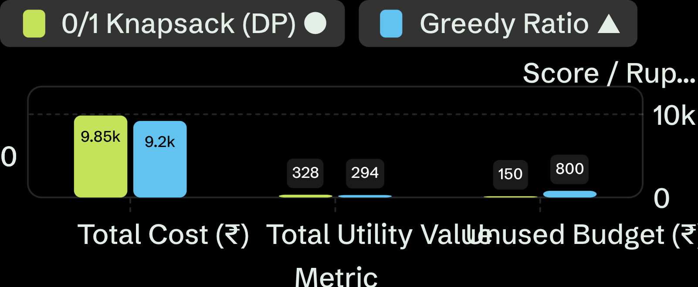
6. Demo & Impact
The demo makes the trade-off visible with a ₹10,000 benchmark run.
=>Screenshots / demo
Sample output
DP: ₹9,850 cost · 328 utility · ₹150 unused.
Greedy: ₹9,200 cost · 294 utility · ₹800 unused.
Performance / results
98.5% budget used by DP vs. 92.0% by Greedy; DP delivered +11.6% more utility value.
Practical benefits
Audit logs explain why an item was selected or skipped, turning the recommendation into an actionable decision.
The benchmark shows how better budget utilization translates directly into higher basket value.
06
Notes:
Walk through the benchmark numbers: with a ₹10,000 budget, Knapsack achieved utility 328 versus 294 for Greedy and used more of the available budget, while the audit log explains the missed item choices.

Slide 7
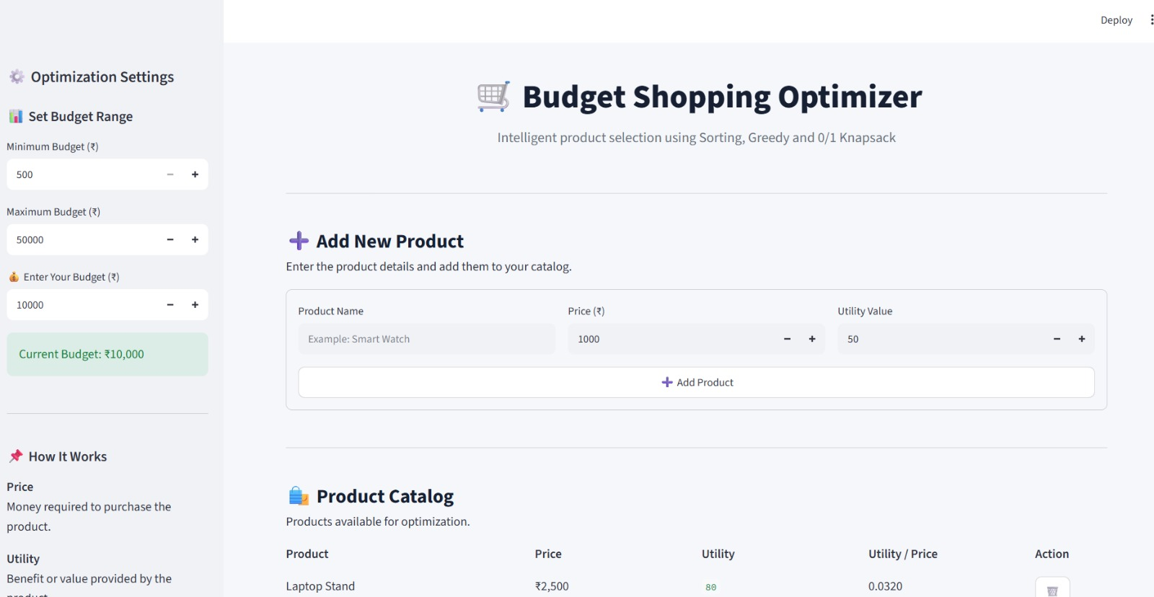
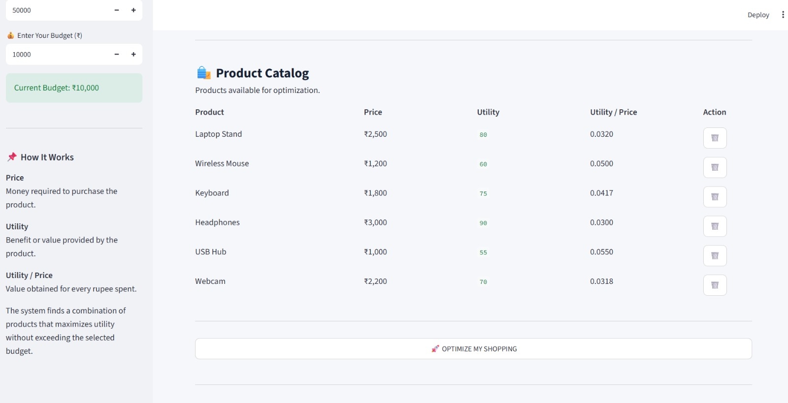

Slide 8
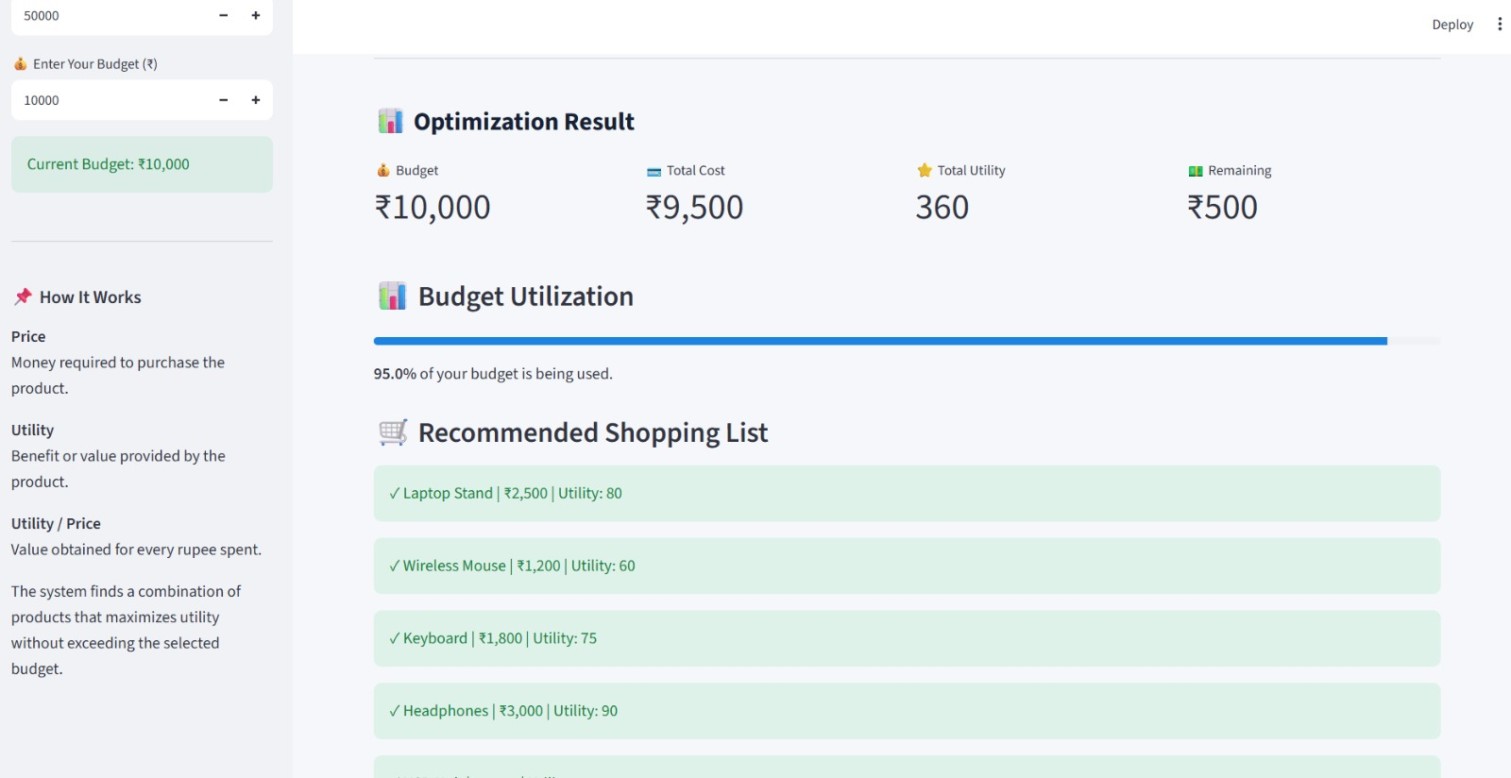
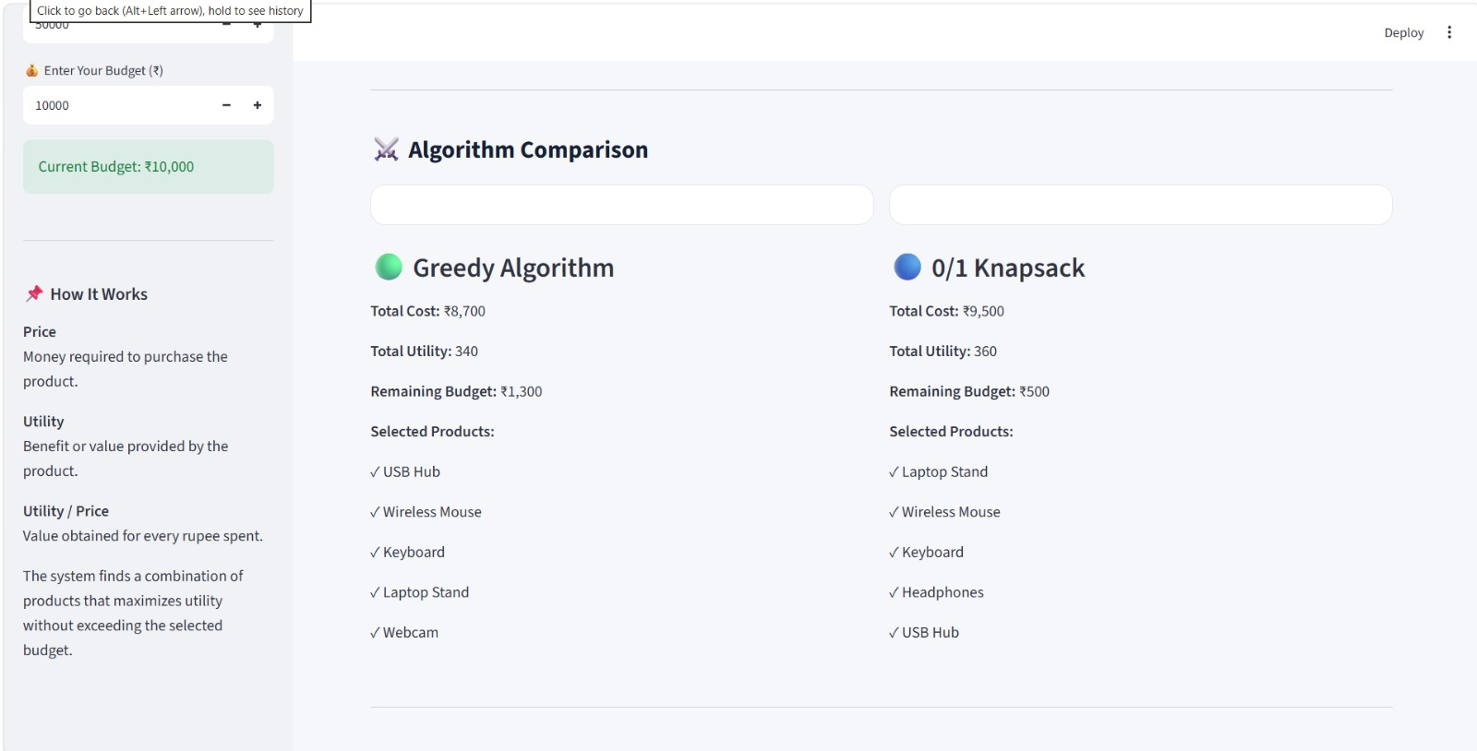

Slide 9
7. Future Vision
We are moving from a functional prototype toward a personalized decision assistant for real-world consumers.
Current achievement
Future improvements
Scalability
A working Streamlit prototype compares optimal and Greedy baskets with transparent item-level explanations.
Support larger catalogs, real-time re-optimization, and constraints such as weight, shelf space, and category minimums.
Add multi-constraint optimization, live store price and coupon APIs, and learned user utilities.
=>Final takeaway
Make every budget decision measurable, optimal, and explainable.
07
Notes:
Close with the current working prototype, the roadmap toward multi-constraint optimization and live personalization, and the final takeaway that better shopping decisions should be measurable and explainable. Thank the judges and invite questions.

Slide 10
THANK
YOU!!

